Slide 1
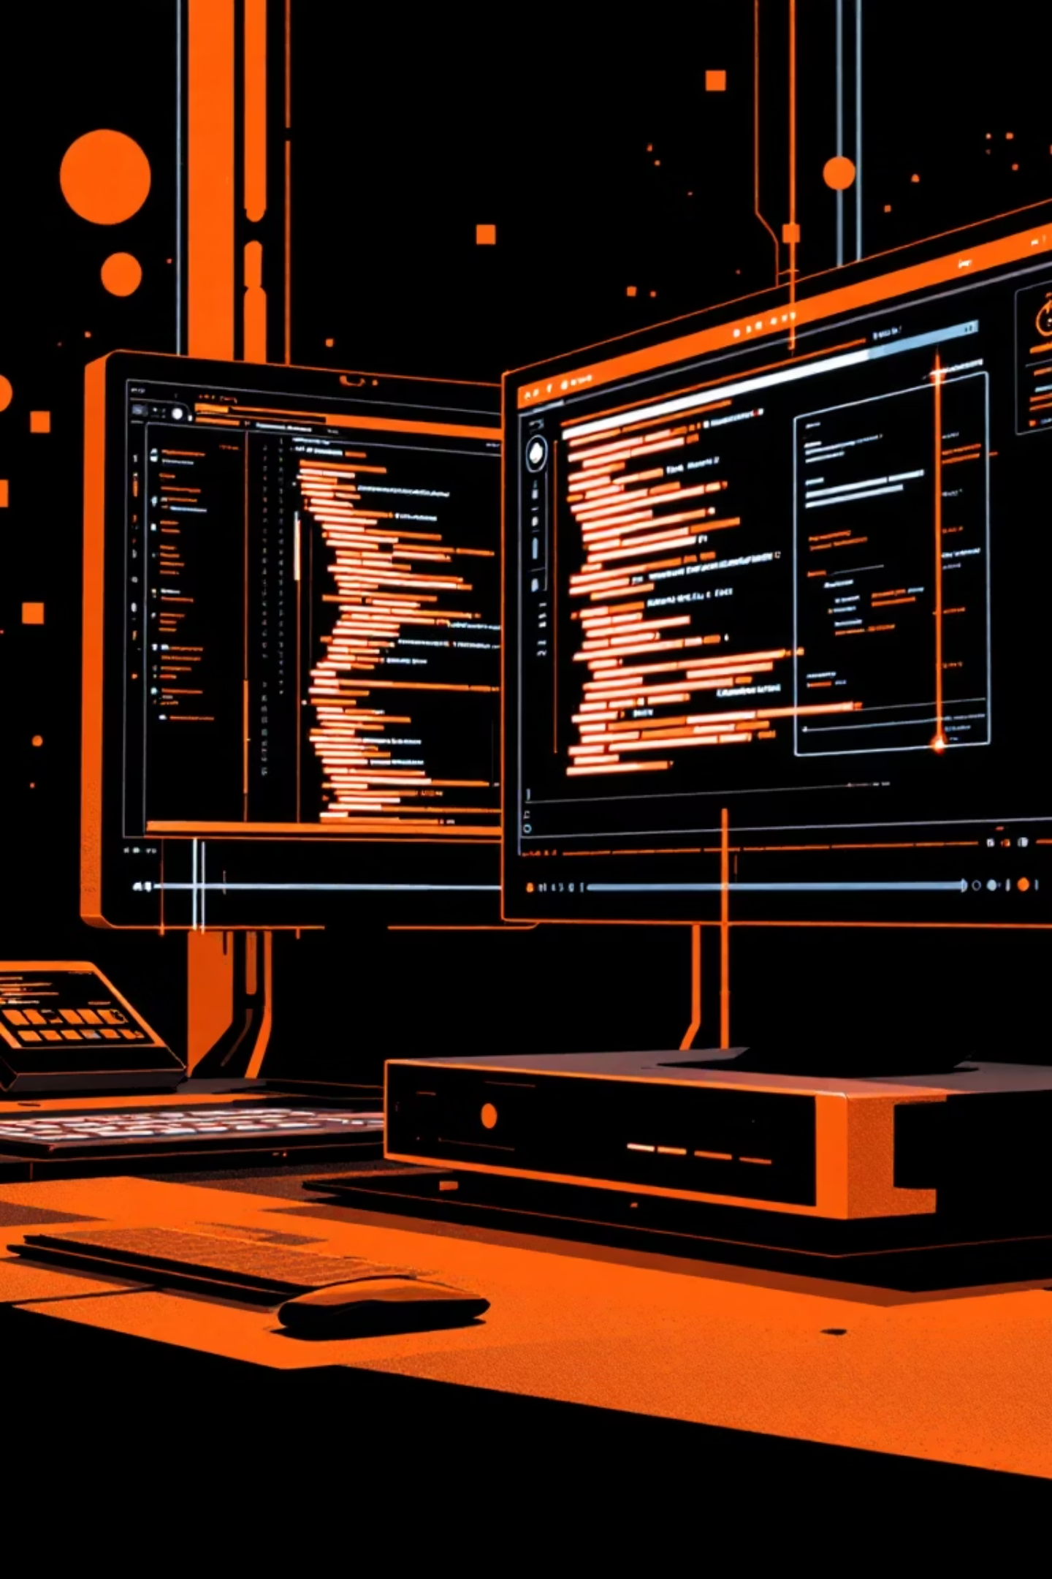
Live-Sync: Real-time File Synchronization
A desktop application designed to sync changes between two files in real-time, ensuring your destination file always reflects updates made to the source.

Slide 2


Key Features
Real-time Sync
Synchronize files instantly between your local editor and lab environment.
Enhanced Editing
Eliminate the need to use less powerful editors for coding tasks.
Boosted Productivity
Improve workflow efficiency with automatic, real-time updates.
Simple Interface
Designed for ease of use, making file synchronization straightforward.

Slide 3

Motivation Behind Live-Sync
This project addresses a common frustration in lab sessions: the inefficiency of writing code in basic default editors like Ubuntu's Genome editor.
Modern editors offer intelligent code suggestions, syntax highlighting, and error detection, which are often missing in lab environments.
Live-Sync bridges this gap, allowing developers to use fully-featured editors while automatically reflecting changes in the lab, boosting productivity and reducing manual errors.

Slide 4

Technology Stack
Electron JS
React JS
For building cross-platform desktop applications.
For developing dynamic and responsive user interfaces.
File System Management
Node JS
Utilizing Chokidar and fs for robust file monitoring.
For server-side logic and application backend.

Slide 5


Installation & Author
Get Live-Sync
Meet the Author
Download the latest version for your operating system:
Live-Sync was developed by:
Windows OS
NIRANJAN B M
Mac OS
GitHub Profile
Linux OS

